Slide 1

SMART STICK FOR BLIND PEOPLE

Slide 2

MEMBERS
9920004053 – JAYAKUMAR S
9920004060 – KAMALAKANNAN P
9920004087 – MOHAMED SULTHAN ISHAQ A
9920004095 – PADMANABAN S
Ms. G. KOTHAI
GUIDED BY

Slide 3

road map
OBJECTIVE
LITERATURE REVIEWS
ISSUES TO BE ADDRESSED
COMPONENTS
WORK PLAN
REFERENCES

Slide 4
Objective of the project
MAIN OBJECTIVE
SUB OBJECTIVE
Audio recording feature
-Implementing a button that enables the blind person to record the audio
-Fixing another button to stop the recording and automatically sends the recorded voice data to the trudtable person .
Object detection
-Detecting any obstacle that interferes the way of blind person and alarming them to take right path
GPS location detection
-GPS is integrated in the blind stick which helps the trusted person to locate the exact location of the blind people.

Slide 5
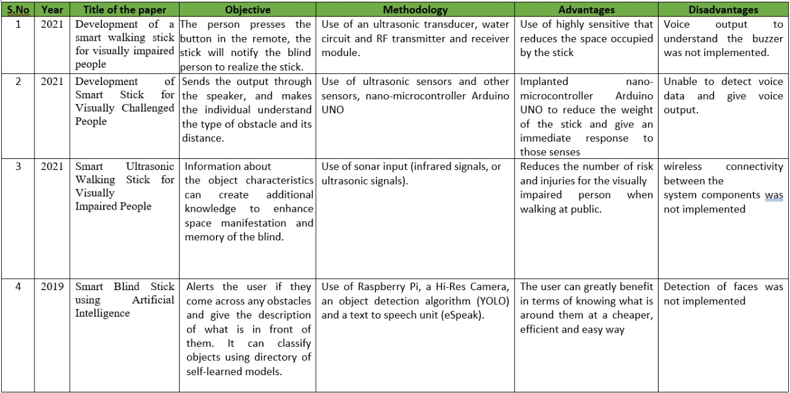
LITERATURE REVIEW

Slide 6
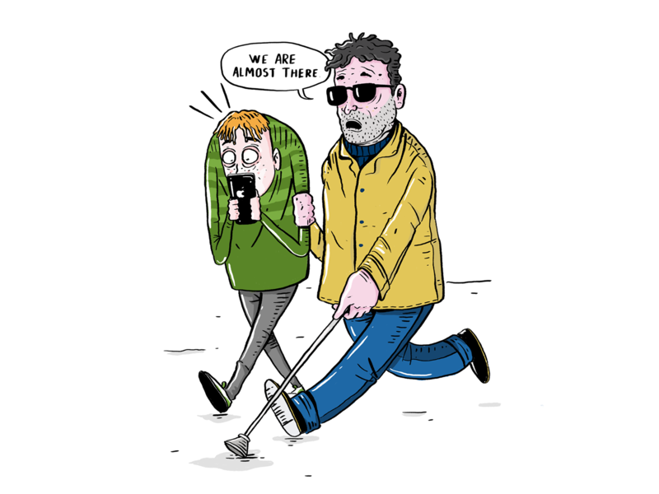
ISSUES TO BE ADDRESSED
To protect the blind people from suspicious persons and collecting audio as evidence.
Audio recordings has to be sent to the guardians device without delay as well as missing.
Obstacles are detected to safeguard the blind people from unnecessary accidents.
The exact location of the blind people can be identified .

Slide 7
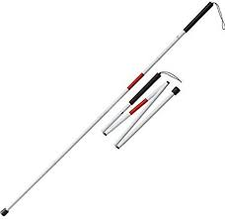
WORK PLAN
MODULE 1
Choosing a walking stick for blind people based on their comfort.
Identifying the sensor for detecting the obstacles.
Integrating the sensor with the walking stick.
Alarm will be raised if object is detected.

Slide 8
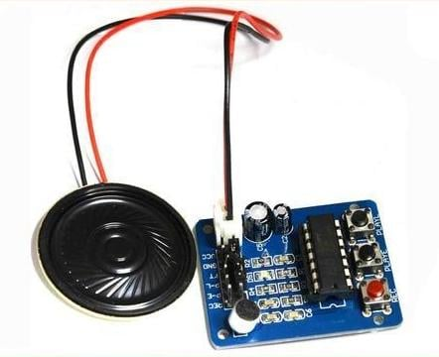
MODULE 2
Identifying the audio recording devices.
Integrating the audio device with the walking stick.
Buttons point.

Slide 9
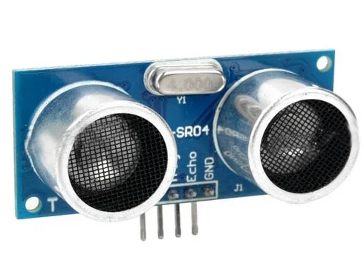
MODULE 3
Importing GPS to direct the blind people to their respective destination.
Sharing the exact location details to the trustable person.

Slide 10
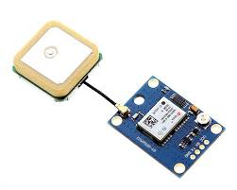
MODULE 4
Pairing the walkable stick with the smart phone.
Storing the recorded audios for further use.
Transmitting the recorded audio to the trustable person via internet.

Slide 11

MODULE 5
Fixing buttons that enables ON and OFF of the recordings.
While the ON button is activated, recording starts.
While the OFF button is clicked, recording stops and transmission of recorded voice data.

Slide 12
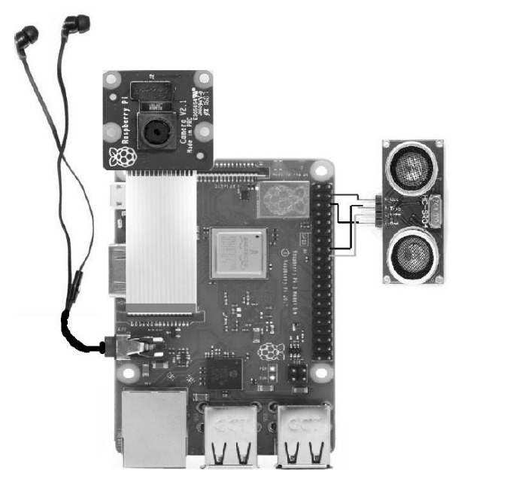
MODULE 6
If time persists, we’ll be adding headphone feature with the audio speaker (output) to avoid external voice.

Slide 13
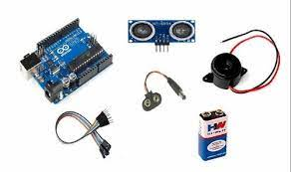
COMPONENTS
PVC PIPE
ULTRASONIC SENSOR HC –SR04
ARDUINO UNO
JUMPER WIRES
3V DC BUZZER
LED
9V BATTERY(Based on requirement)

Slide 14
REFERENCES
Bhavani, R. (2021). Development of a smart walking stick for visually impaired people. Turkish Journal of Computer and Mathematics Education (TURCOMAT), 12(2), 999-1005.
Dhanalakshmi, K. S., Reddy, G. K. S., Reddy, M. V., Sahul, N. B., Sreenath, K., & Pazhani, A. A. J. (2021). Development of Smart Stick for Visually Challenged People. Annals of the Romanian Society for Cell Biology, 17078-17090.
Gbenga, D. E., Shani, A. I., & Adekunle, A. L. (2017). Smart walking stick for visually impaired people using ultrasonic sensors and Arduino. International journal of engineering and technology, 9(5), 3435-3447
Pruthvi, S., Nihal, P. S., Menon, R. R., Kumar, S. S., & Tiwari, S. (2019). Smart blind stick using artificial intelligence. International Journal of Engineering and Advanced Technology (IJEAT), 8(5S), 19-22.
Nowshin, N., Shadman, S., Joy, S., Aninda, S., & Md Minhajul, I. (2017). An Intelligent Walking Stick for the Visually-Impaired People. International Journal of Online Engineering, 13(11).

